Slide 1

MSc. Mechanical Engineering
R&D Engineer Lightning Industry
IT Operations Support Network Monitoring and Automation
Human Resources Training and Development
Krisztián Stancz

Slide 2
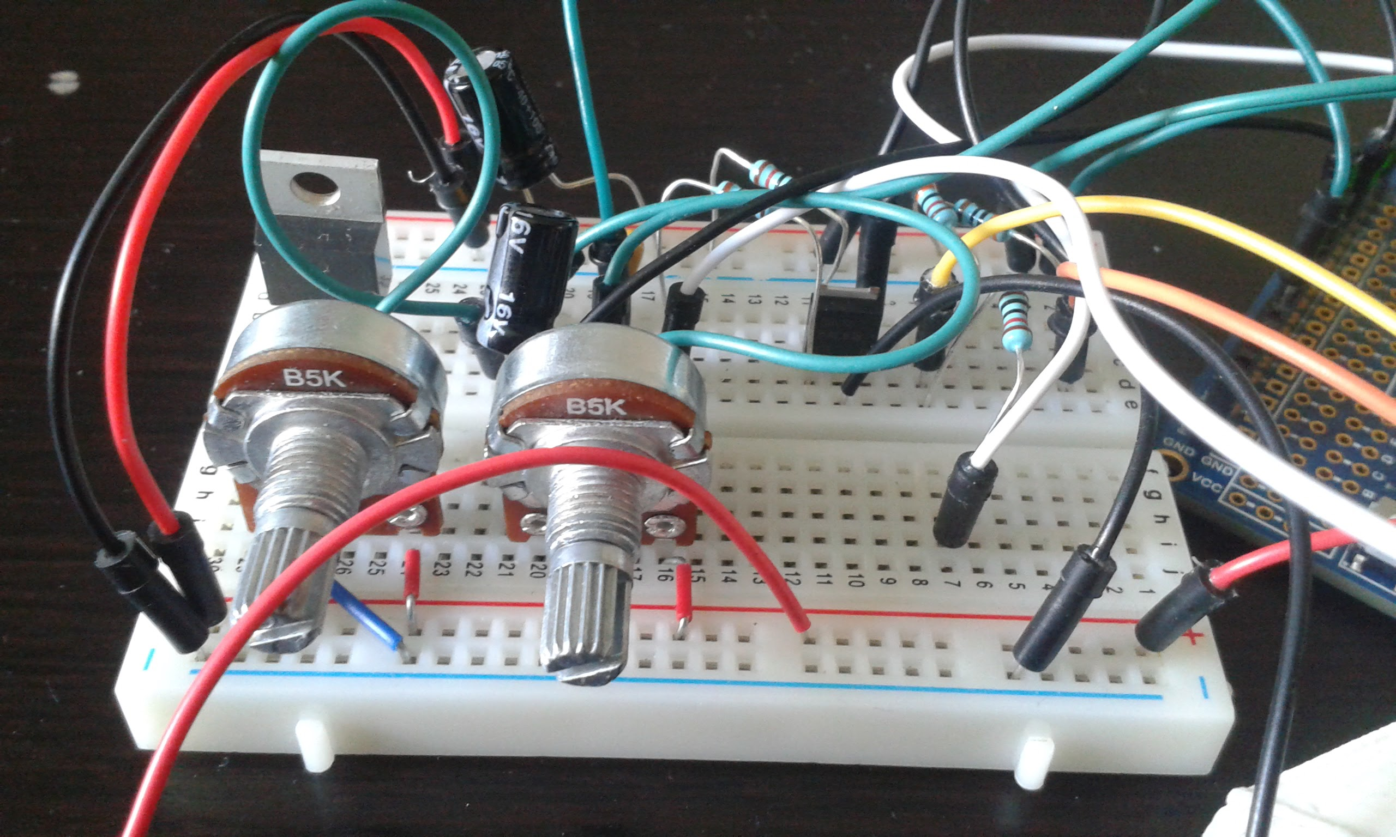
23 June 2017
Embedded reality

Slide 3
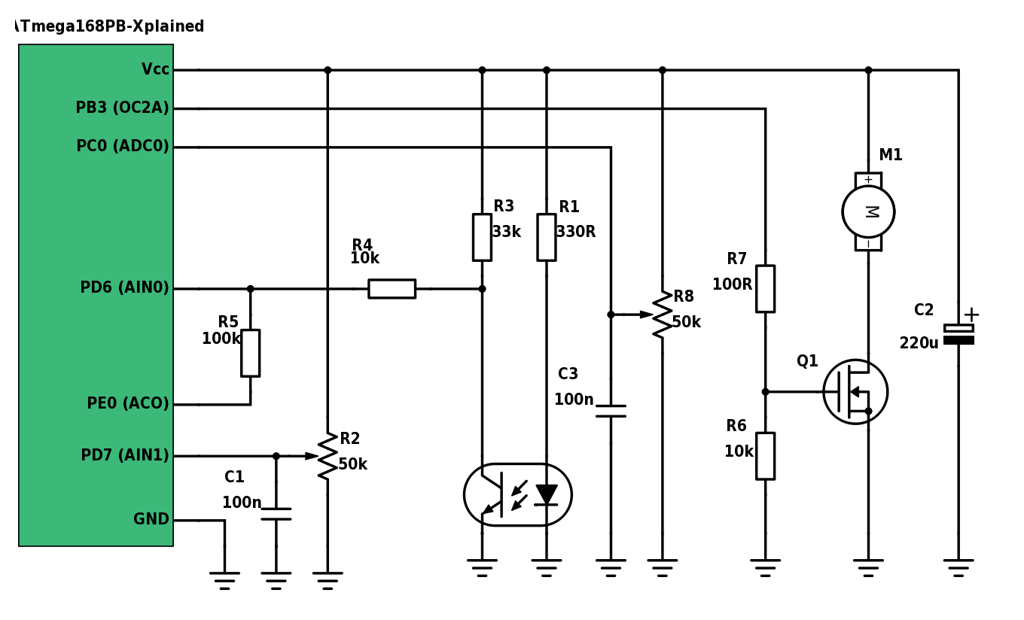
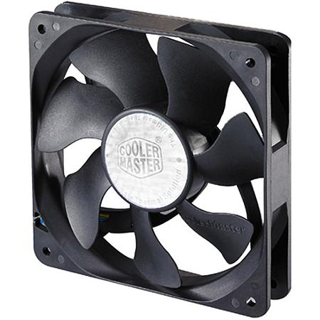
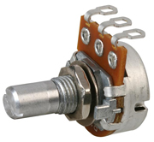
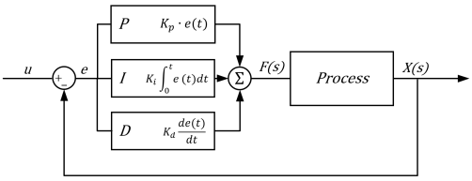

PWM
Analogue
Digital
Converter
Fan
Analogue
comparator
Infrared
sensor
Set reference
RPM
PID controller
Controlled fan
Send data to PC via UART
Closed loop control

Slide 4
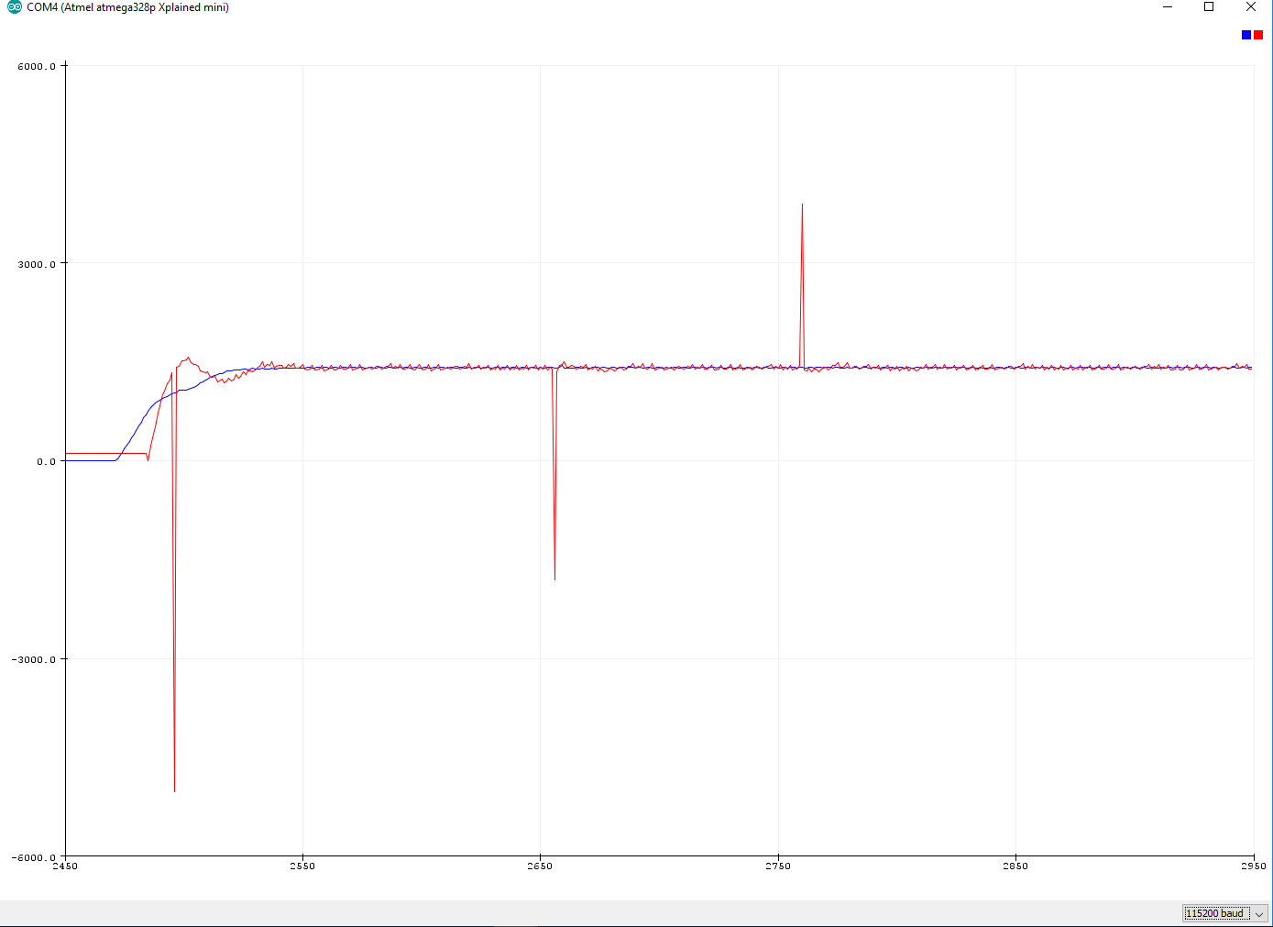
Reference
Actual
Sufficient tracking with
PID controller
It works!

Slide 5
Reference
Actual
Sufficient tracking with
PID controller
But what are these??
It works?

Slide 6
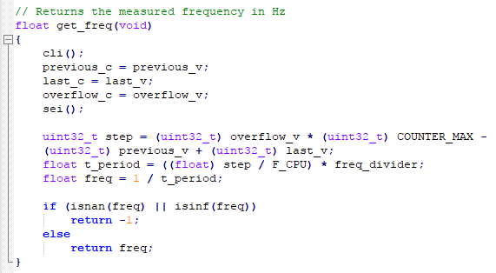
Maybe the plotting software?
Check RPM measurement code
Check frequency measurement code
Maybe the UART?
Let’s use some else’s code
Let’s use some else’s hardware
Let’s debug!

Slide 7
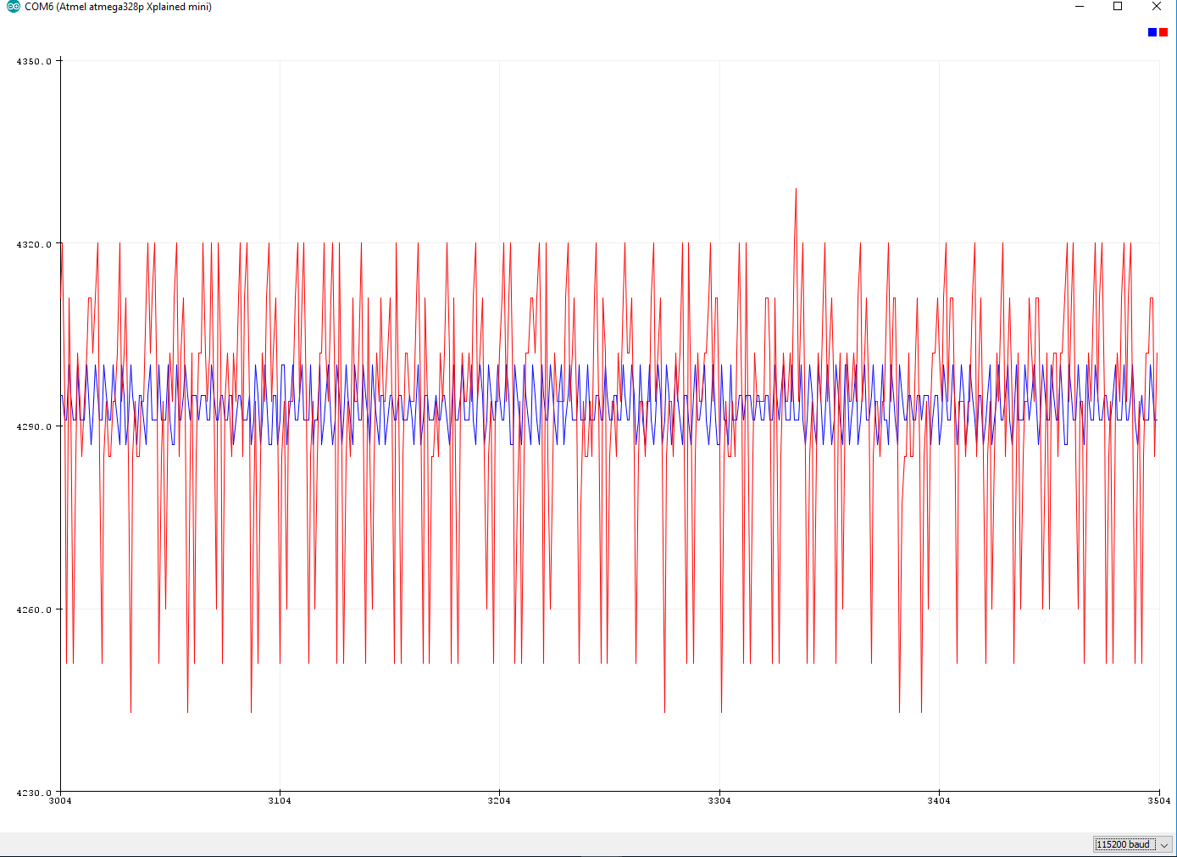
Reference
Actual
0.6%
Can we break it?

Slide 8
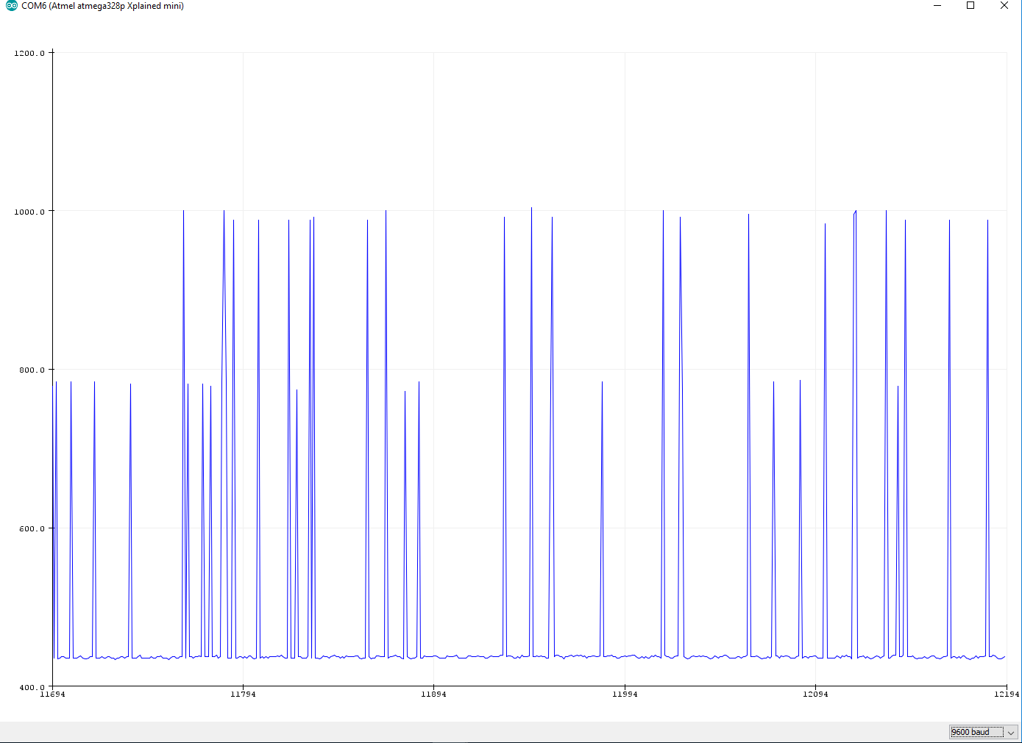
Actual
130%
Yes, we can!

Slide 9
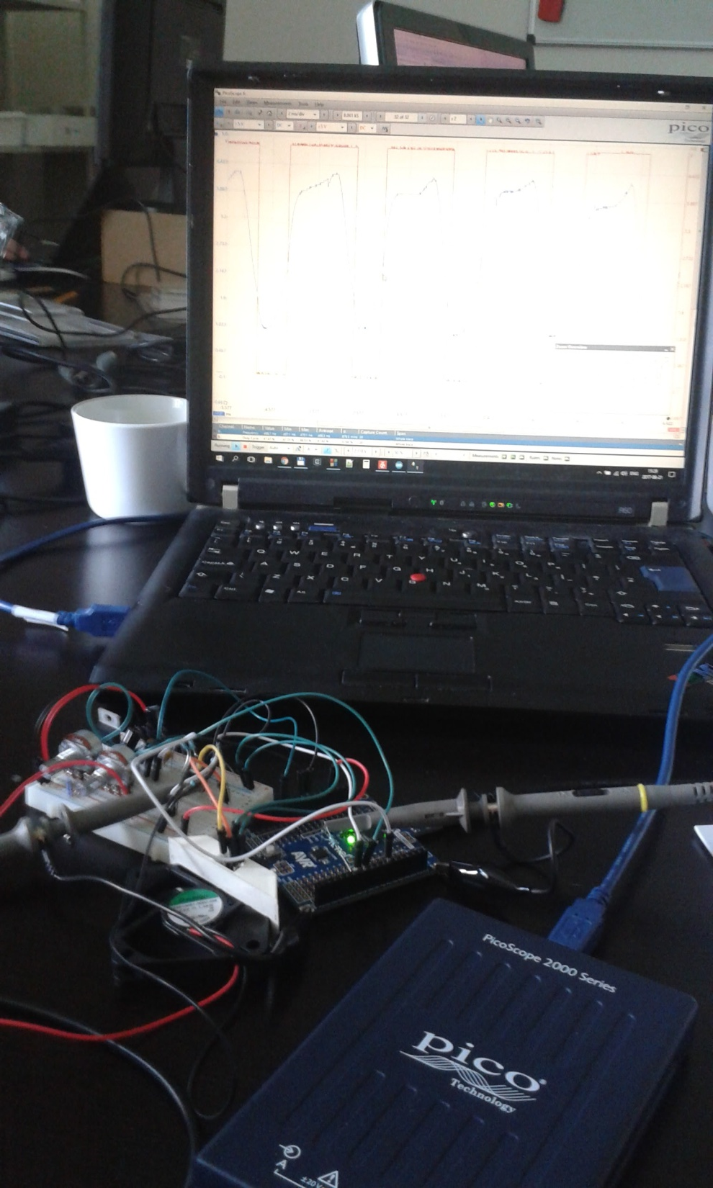
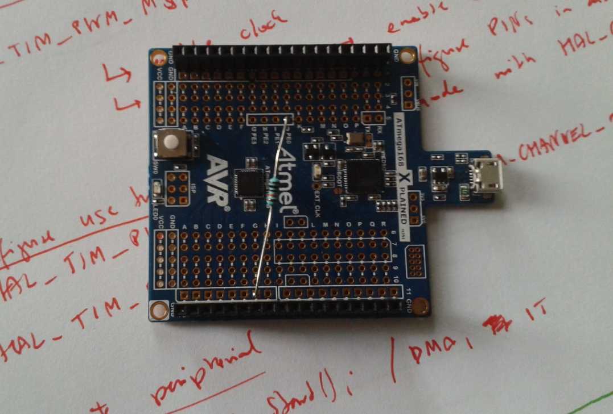
Bring in the ‘scope!

Slide 10
You need to understand
the hardware enough,
to tell when it is broken.

